Slide 1
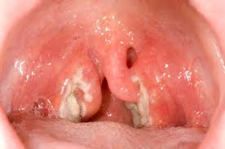

Slide 2
Pharyngitis and Laryngitis
ENT Department
Prepared By: Dr. Natnael ORL Surgeon
Presented By: Dr Abdisalam M.Musa ENT SHO

Slide 3
Objective
To recognize and treat
diseases of the pharynx-larynx and their complication.

Slide 4
Pharynx:
Comprises three parts.
Nasopharynx.
Oropharynx.
Hypopharynx
Waldeyer’s ring.
Adenoid’s. (in the midline at the junction of the roof and posterior wall)
Tubal tonsil on the lateral wall behind the Eustachian tube opening
Palatine tonsil. In between the anterior and posterior pillars
Lingual tonsil Posterior 1/3rd, i.e. base of tongue

Slide 7
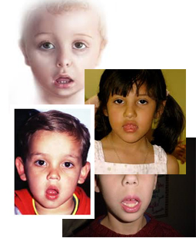
Adenoids:
Adenoid hypertrophy is a common cause of nasal obstruction in children. It can present as:
Chronic or recurrent nasal discharge.
Snoring.
Rrecurrent otitis media or Eustachian tube dysfunction
History of mouth breathing.
Hyponasal voice
Classic adenoid facies, characterized by an incompetent lip seal, a narrow upper dental arch, increased anterior face height, a steep mandibular plane angle, and a retrognathic mandible.

Slide 8
PHARYNGITIS
Conditions of local inflammatory origin in the pharynx are called pharyngitis and we will consider them as a local manifestation of a general infection. It can be acute or chronic.

Slide 9
Acute pharyngitis
Acute pharyngitis is usually a benign, self-limiting illness with average length of illness lasting for 1 week.

Slide 10
Pharyngitis Etiology
Bacterias: Viruses:
-Group A Strept. -Rhinovirus
-Sp. Strept -Coronavirus
-Mycoplasm -Adenovirus
-Corynae Bact. -HIV
-Diphteriae -EBV
- S. Gonorrheae -HSV
-Toxoplasma -Enterovirus
\

Slide 11
Viral Pharyngitis
Physical Exam
VIRAL
EBV – White exudate covering erythematous pharynx and tonsils, cervical adenopathy,
Subacute/chronic symptoms (fatigue/myalgias)
transmitted via infected saliva
Adenovirus/Coxsackie – vesicles/ulcerative lesions present on pharynx or posterior soft palate
Also look for conjunctivitis

Slide 12
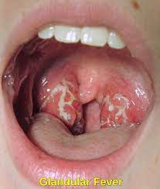
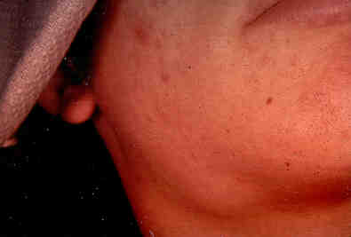
Virals Pharyngitis Infectious Mononucleosis

Slide 13
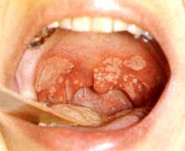
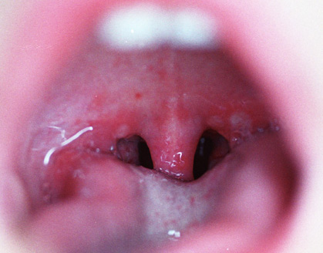
Virals Pharyngitis: Herpangina

Slide 14
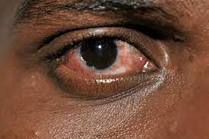
Virals Pharyngitis
Conjunctivitis:
Adenovirus

Slide 15
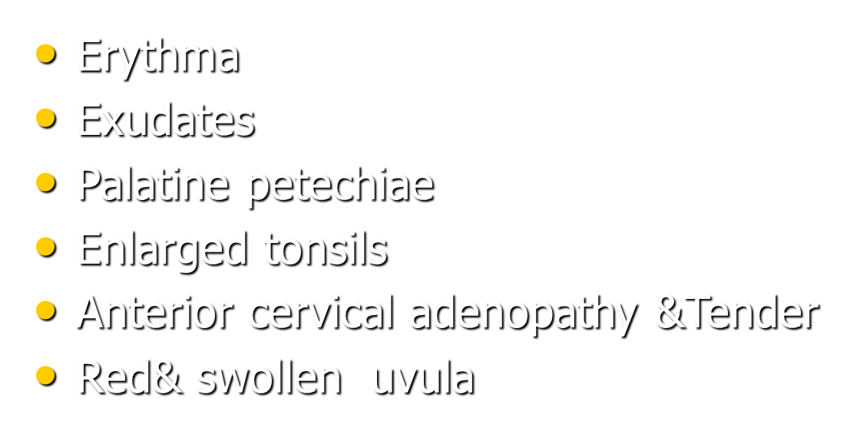
Clinical manifestations bact. Pharyngitis GABHS
Rapid onset
Headache
GeneraI Symptoms
Sore throat

Slide 17
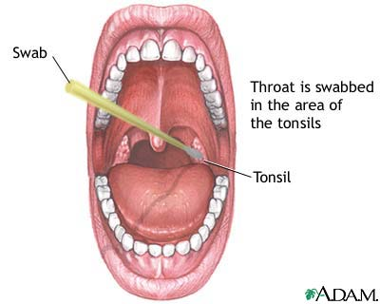
Diagnostic
Strep:
Throat culture(Gold standard)
Rapid Strep. Antigen kits
Infectious Mono.:
CBC(Atypical lymphocytes)
Spot test (Positive slide agglutination)

Slide 18
Differential diagnosis of pharyngitis
Vesiculation & Ulceration HSV
Gingivostomatitis Coxsackievirus
Conjunctivitis Adenovirus
Gray-white fibrinous pseudomembrane
with marked cervical lymphadenopathy Diphteria
Macular rash Scarlet fever
Hepatosplenomegaly &Rash
&Fatigue &Cervical lymphadenitis EBV

Slide 19
Acute Pharyngitis GABHS Treatment
Treatment → Do so to prevent ARF (Acute Rheumatic Fever)
GAS →
Oral PCN – treatment of choice
10 day course of therapy
IM Benzathine PCN G – 1.2 million units x 1year
Azithromycin, Clindamycin

Slide 20
Viral Pharyngitis
Treatment
Supportive care only – Analgesics, Antipyretics, Fluids
No strong evidence supporting use of oral or intramuscular corticosteroids for pain relief
EBV – infectious mononucleosis
activity restrictions – mortality in these pts most commonly associated with abdominal trauma and splenic rupture

Slide 21
A. Pharyngitis Complications
Suppuratives Complications
Non-supuratives Complications

Slide 22
Suppurative Complications GAS Pharyngitis
Otitis media
Rhinosinusitis
Peritonsillar and retropharyngeal abscesses
Suppurative cervical
adenitis

Slide 23
NonSupurative Complications GAS Pharyngitis
Acute rheumatic fever
follows only streptococcal pharyngitis (not group A strep skin infections)
Acute glomerulonephritis
May follow pharyngitis or skin infection (pyodermatitis)
Nephritogenic strains

Slide 24
Chronic Pharyngitis
Is the inflammation of the mucous membrane of the pharynx with hyperplasia of its various elements.
Etiology: Is often somewhat obscure.
Smoking, Alcohol.
Atmospheric pollution.
Gastroesophageal reflux disease (GERD)
Appearance: In the simple form general redness of the posterior pharyngeal wall, the mucous membrane is thickened and reddened and degree of edema of the uvula. There is increase in the size of the lymphoid of the posterior pharyngeal wall.
Treatment: Eliminate the cause (alcohol, smoking.)

Slide 25
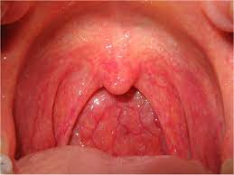

Slide 26
ACUTE AND CHRONIC INFLAMMATIONS OF LARYNX
Laryngitis is defined as an inflammation of the laryngeal mucosa; will be Acute when the
symptomatology is established in a short period of time, hours or days; in case the symptoms last for more than three weeks we will be talking about Chronic Laryngitis

Slide 27
Acute laryngitis may be
Infectious or non-infectious,

Slide 28
Infectious acute laryngitis.
Viral laryngitis etiology.
Catarrhal laryngitis.
Influenza laryngitis.
Herpetic laryngitis.
Bacterial etiology laryngitis.
Mycoplasma laryngitis.
Diphtheritic laryngitis.
Other bacteria.
Fungal laryngitis etiology
Candidal laryngitis.
Aspergillus laryngitis.
Histoplasmic laryngitis.
Epiglottitis.
Perichondritis.

Slide 29
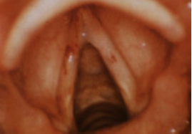
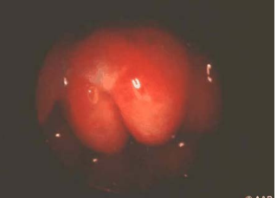
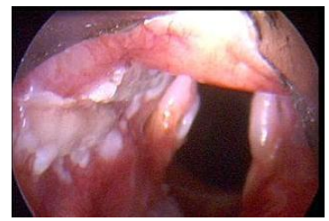

Slide 30
Non-infectious acute laryngitis.
Allergic or hypersensitivity laryngitis.
Drug laryngitis by non-immunological mechanism.
Acute inhalational or thermal laryngitis, and caustic laryngitis and/or reflux laryngopharyngeal.
Laryngitis due to trauma or vocal effort.
Autoimmune laryngitis.

Slide 31
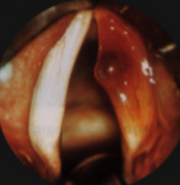
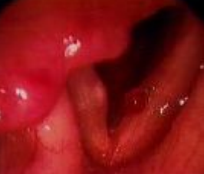

Slide 32
Laryngeal appearances vary with severity of disease.
In early stages, there is erythema and oedema of epiglottis, aryepiglottic folds, arytenoids and ventricular bands, but the vocal cords appear white and near normal and stand out in contrast to surrounding mucosa, betraying the degree of hoarseness patient has.
Later, hyperaemia and swelling increase. Vocal cords also become red and swollen.
Subglottic region also gets involved. Sticky secretions are seen between the cords and interarytenoid region.
In case of vocal abuse, submucosal haemorrhages may be seen in the vocal cords.

Slide 34
Clinical Features
Symptoms are usually abrupt in onset and consist of:
1. Hoarseness which may lead to complete loss of voice.
2. Discomfort or pain in throat, particularly after talking.
3. Dry, irritating cough which is usually worse at night.
4. General symptoms of head, cold, rawness or dryness of throat, malaise and fever if laryngitis has followed viral infection of upper respiratory tract or bacterial infection.

Slide 35
Treatment
Vocal rest. This is the most important single factor. Use of voice during acute laryngitis may lead to incomplete or delayed recovery.
Steam inhalations with Tr. Benzoin Co, oil of eucalyptus are soothing and loosen viscid secretions.
Avoidance of smoking and alcohol
Cough sedative. To suppress troublesome irritating cough.
Antibiotics. When there is secondary infection withfever and toxaemia or purulent expectoration.
Analgesics. To relieve local pain and discomfort.
Steroids. Useful in laryngitis following thermal or chemical burns.
Intubation /tracheostomy is done, should respiratory obstruction increase in spite of the above measures.

Slide 36
Croup (laryngotracheobronchitis )
Term applied to group of inflammatory conditions involving larynx , trachea and characterized by Triad :
Inspiratory stridor
Brassy cough
Hoarseness of voice +/_ resp. distress

Slide 37
Usually viral in origin
- Parainfluenza virus (type 1)
- Influenza virus
- RSV , adenovirus , measles virus
It is the most common cause of Acute Airway Obstruction in children
Age group 3m-3 years (peak 2years)
Affects boys more often than girls
Peak occurrence is in fall and winter

Slide 38
Clinical features
Gradual or sudden in onset
Triad :
Inspiratory stridor
Brassy cough
Hoarseness of voice +/_ resp.distress

Slide 39
Diagnosis
It is clinically diagnosed
Neck x-ray and CBC all should be done in clinically stable pt .
- AP neck film : show a pencil tip or steeple sign of the subglottic trachea
- CBC , it may helps .

Slide 40
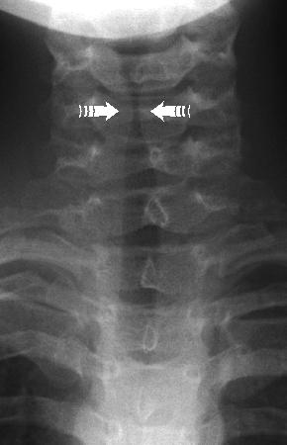
Pencil shaped or steeple sign

Slide 41
Do not use a radiograph to make management decisions in a pt. with an unstable airway

Slide 42
Treatment
Some children improve spontaneously because of natural fluctuations in the disease
- Mist therapy / Steam inhalation
Oxygen
Adequate hydration
Nebulization with Racemic epinephrine

Slide 43
Do we use steroid in mild croup ?

Slide 44
For Children with mild croup , dexamethasone is an effective treatment that results in consistent and small but important clinical and economic benefits

Slide 45
Steroid
Used in moderate to severe croup
A child who needs admission in ICU for croup management needs steroid

Slide 46
Which is more effective oral or nebulized dexamethasone for children with mild croup ?
Children with mild croup who receive oral dexamethasone Rx are less likely to seek subsequent medical care and demonstrate more rapid symptom resolution compared with children who receive nebulized dexamethasone or placebo Rx

Slide 47
Most children with croup doesn't need hospitalization because symptoms typically resolve within a few days

Slide 48
ICU admission
Signs of hypoxia
Severe distress with exhaustion
Decision about ventilation

Slide 49
Acute epiglottitis
It is a rapidly progressive bacterial infection causing acute inflammation and edema of the epiglottis and adjacent structures : aryepiglottic folds and arytenoids
Also known as supraglottitis
It is life threatening condition may lead to sudden and complete airway obstruction

Slide 50
Age : 2-6 years ( peak at 3 year)
Infant, older children and adult are rarely affected
Causative agents :
- HIB
- pneumococci, staphylococci,
streptococci

Slide 51
Clinical features
Previously well child
Sudden onset, history is short, 4-12 hours of sore throat and high fever
4 “ D ” Distress
Dysphagia
Dysphonia
Drooling of saliva
may lead to death if complete airway obstruction

Slide 52
Diagnosis
History
Presentation
Appearance of the child
Pharynx examination at this stage in ER is absolutely contraindicated
Next step = admission in ICU
Neck x-ray : Not the priority
Do not leave the patient unattended

Slide 53
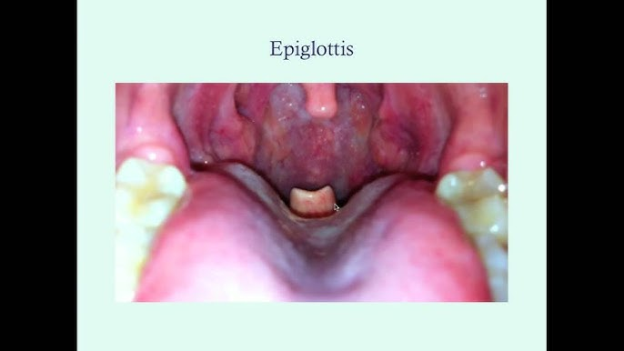

Slide 54
Management
Protection of the airways is the primary priority
Quickly proceed with epiglottitis protocol
It is better to initiate a “false” epiglottitis drill than to miss this disease

Slide 55
Epiglottitis Protocol
Safe and supervised transfer to skilled hand
- Inform consultant Pediatrics, ENT, ICU, Anesthesia
- Don't attempt to examine throat in ER
- Keep patient as comfortable as possible
- Administering 100% O2

Slide 56
Assembling at bedside CPR equipment including resuscitation bag and mask, intubation equipment
- Taking the pt. to OR
- Attempt IV line or sampling only after intubation in OR /or Tracheostomy

Slide 57
After epiglottitis protocol has been performed and pt has secure airways you can do :
- blood culture : usually positive for HIB
- CBC : WBC may be moderately elevated
- lateral neck radiograph : shows a thickened epiglottis ( thumb sign )

Slide 58
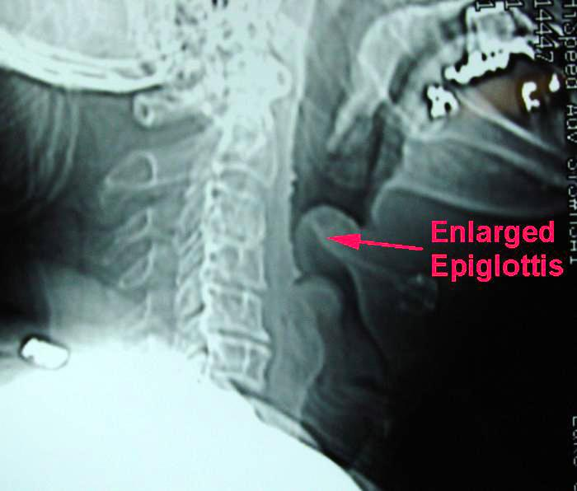
Thumb sign

Slide 59
Diagnosis confirmed by seeing an edematous cherry-red epiglottis on endoscopy
Endoscopic examination should not be performed in advance of the epiglottitis protocol

Slide 60
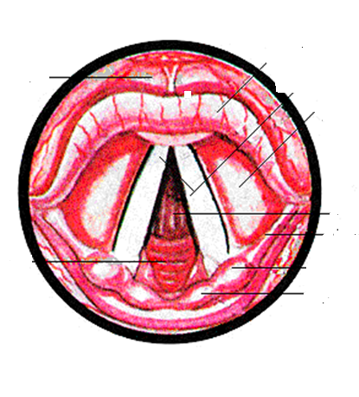
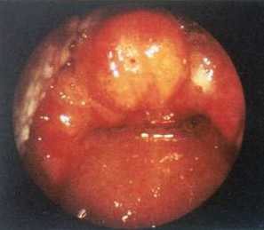

Slide 61
The main components of Rx is :
- maintain adequate airways until inflammation and edema resolve often 36-72hrs
- Parenteral Abx directed against HI assuming this is the cause: ceftriaxone or cefotaxime
- if not available may use chloramphenicol f Rx : 7-10 days

Slide 62
Prophylaxis
if there is another child in the house ≤ 4 years not vaccinated to HI give Rifampicin to all family members

Slide 63
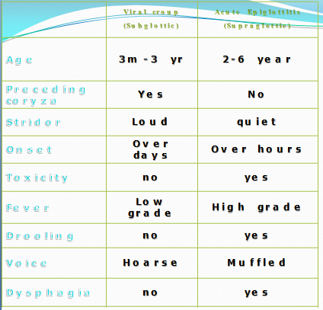
Comparison between croup and acute epiglottitis

Slide 64
CHRONIC LARYNGITIS
It is a diffuse inflammatory condition symmetrically involving the whole larynx, i.e. true cords, ventricular bands, interarytenoid region and root of the epiglottis.

Slide 65
Aetiology
It may follow incompletely resolved acute simple laryngitis or its recurrent attacks.
Presence of chronic infection.
Occupational factors, e.g. exposure to the dust and fumes such as in miners, stroker“, gold or iron smiths and workers in chemical industries
Smoking and alcohol
Persistent trauma of cough as in chronic lung diseases.
Vocal abuse.

Slide 66
Clinical features
Hoarseness. This is the commonest complaint . Voice becomes easily tired and patient becomes aphonic by the end of the day.
There is dryness an intermittent tickling in the throat and patient is compelled to clear the throat repeatedly.
Discomfort in the throat.
Cough. It is dry and irritating.

Slide 67
Examination.
Laryngeal mucosa, in general, is dusky red and thickened.
Vocal cords appear red and swollen. In late stages cords become bulky and irregular giving nodular appearance.
Ventricular bands appear red and swollen and maybe mistaken for prolapse or eversion of the ventricule.
Mobility of cords gets impaired due to odema and infiltration.

Slide 68
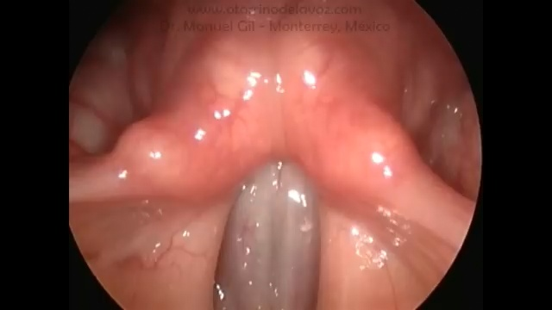

Slide 69
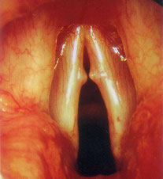
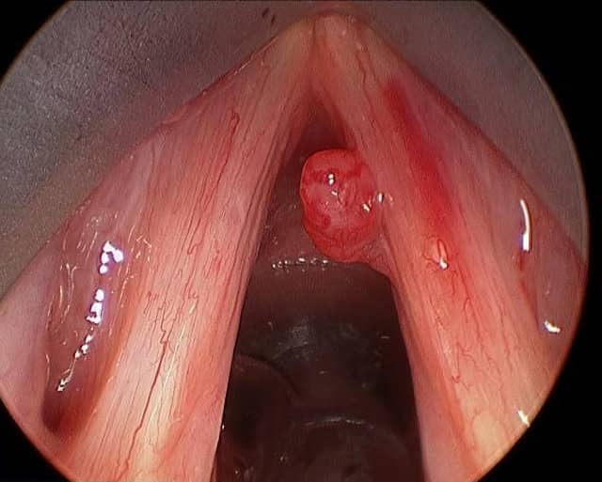
vocal cord polyp
vocal cord nodules

Slide 70
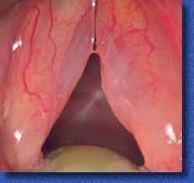
Reinke's edema

Slide 71
Treatment
Eliminate infection of upper or lower respiratory tract. Infection in the sinuses, tonsils, teeth or chronic chest infection (bronchitis, bronchiectasis,
tuberculosis, etc.) should be treated.
Avoidance of irritating factors, e.g. smoking, alcohol or polluted environment, dust and fumes.
Voice rest and speech therapy. Voice rest has to beprolonged for weeks or months. Patient should receive training in proper use of voice.
Steam inhalations. They help to loosen secretions and give relief.
Expectorants. They help to loosen viscid secretions and give relief from hawking.

Slide 72
Treatment
Surgical. Stripping of vocal cords, removing the hyperplastic and oedematous mucosa, may be done in selected cases.

Slide 73
Topic for read
Diphtheria pharyngitis
Chronic Adenotonsillitis
Chronic laryngitis

Slide 74
References
Armando Lenis, MD and Tibor Ruff, MD Editors for 1st Tonsillectomy and Adenoidectomy Lecture series
PL Dhingra. Disease of ear, nose and throat. Seventh Ed.
Clinical Photos
Greg Allen, MD University of Colorado

Slide 75
Thank you

